Slide 1
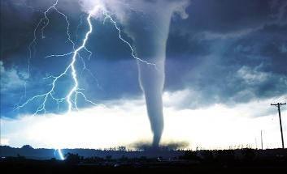
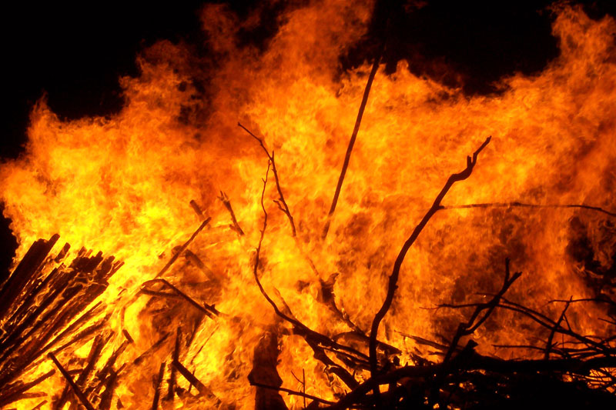
Crisis Plan
Will you know your role?

Slide 2
Pink Crisis Plan Flip Chart
CPR Certified Staff
Hall Captains
Run–Hide–Fight
Bomb Threat
Fire
Tornado

Slide 3
Fire Drill
General Reminders
Take Crisis folder with updated class roster
Have students take only essentials (purses/keys)
Take attendance once in designated area
Hold up green card if attendance is accurate
Hold red folder up if missing any students
Do not hang out with other staff – take it seriously
Administrators near you…
Sports Complex: Perkins/Church
Rochester: Padgett/Orsak
CDC/Minisa Bridge: Myrick
Statue/13th Crosswalk: Mock
ATC/Rochester: JB
Floating: Larkins

Slide 4
Tornado Drill
General Reminders
Take crisis folder with updated class rosters
Have students leave backpacks in the classroom
Take attendance once in shelter
Hold green card up if attendance is accurate
Hold red folder up if missing any students
Administrators near you…
New Gym Foyer: Perkins/Church
New Gym Locker rooms: Myrick/JB
Wrestling Room Entrance: Larkins
Wrestling Room Back Entrance: Orsak
Wrestling Room: Riveros
A & G Intersection: Mock
Floating: Padgett
Notes:
Expect inaccurate attendance. Goal is to get students into facility if a tornado is coming. Some students may only make it to secondary shelters. Locate administrator/radio handler to inform of inaccurate attendance in a real event.

Slide 6
Traffic Logistics
First Floor rooms
A, B, and C halls as well as the Library and Auditorium are assigned to the new locker rooms and will enter via A hall and the East side of the new gym
D, E, and F halls as well as the Lecture hall and Cafeteria are assigned to the new wrestling room and will enter through both entrances via G hall past the new weight room

Slide 7
Traffic Logistics
2nd and 3rd Floor Rooms
All rooms that currently use the NE and SE stairwells during fire drills will proceed north through 1st floor A hall and enter the new locker rooms walking along the east side of the new gym
All rooms that currently use the NW, SW, and F hall stairwells during fire drills will proceed north through the 1st floor G hall and enter the new wrestling room through both entrances walking along the east side of the new weight room

